Slide 1
High energy physics particle tracking
BIRLA VISHVAKARMA MAHAVIDYALAYA
FULL SEMESTER EXTERNAL PROJECT
MID - 1
PRESENTED BY : 15CP032 - ROMIL SIDDHAPURA
15CP040 - HEENAL SAPOVADIA

Slide 2
Introduction of Project
Particle Physics
Particle physics investigates the irreducibly smallest detectable particles and the fundamental interactions necessary to explain their behaviour.
High energy physics is a branch of physics that studies the nature of the particles that constitute matter and radiation.
The currently dominant theory explaining these fundamental particles and fields, along with their dynamics, is called the Standard Model.

Slide 3
2. Large Hadron Collider
The Large Hadron Collider (LHC) is the world's largest and most powerful particle collider and the largest machine in the world.
It was built by the European Organization for Nuclear Research (CERN) between 1998 and 2008 in collaboration with over 10,000 scientists and hundreds of universities and laboratories, as well as more than 100 countries.
It lies in a tunnel 27 kilometres (17 mi) in circumference and as deep as 175 metres (574 ft) beneath the France–Switzerland border near Geneva.
The aim of the LHC is to allow physicists to test the predictions of different theories of particle physics, including measuring the properties of the Higgs boson and searching for the large family of new particles predicted by supersymmetric theories

Slide 4
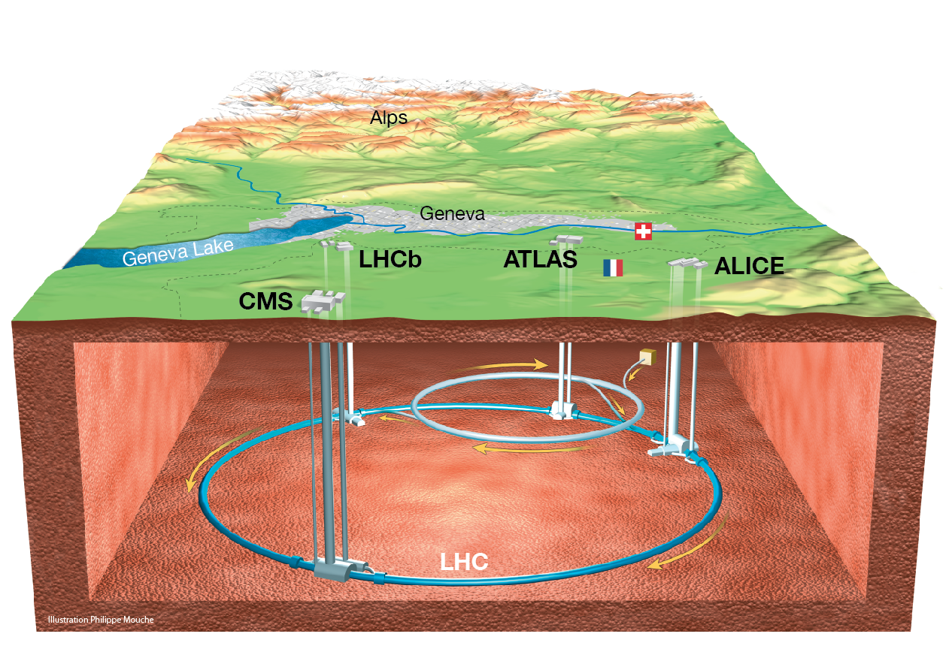

Slide 5
3. Experiments
ATLAS (A Toroidal LHC ApparatuS): One of two general-purpose detectors. ATLAS studies the Higgs boson and looks for signs of new physics, including the origins of mass and extra dimensions.
CMS (Compact Muon Solenoid): The other general-purpose detector, like ATLAS, studies the Higgs boson and look for clues of new physics.
ALICE (A large Ion Collider Experiment): ALICE is studying a "fluid" form of matter called quark–gluon plasma that existed shortly after the Big Bang.
LHCb (Large Hadron Collider beauty): Equal amounts of matter and antimatter were created in the Big Bang. LHCb investigates what happened to the "missing" antimatter.

Slide 6
4. Higgs Boson
Physicists’ realisation - Close ties between two of the four fundamental forces – the weak force and the electromagnetic force.
Associated force-carrying particles - photon, and the W and Z bosons.
A Major Glitch!!
All of these particles have NO mass according to theory.
It is true for photon, but W and Z have mass, 100 times that of a proton.
Scientists proposal of solution!!
There must be some mechanism which gives mass to the W and Z bosons when they interact with an invisible field. Scientists named this the Higgs Field and propose that it pervades the entire universe.
The particle associated with this Higgs field was named the Higgs boson as it was responsible for giving mass to bosons.

Slide 7
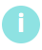
5. Triggering and Data Acquisition
At peak performance, up to one billion proton-proton collisions per second, with a combined data volume of more than 60 million megabytes per second are observed.
Only a few of these events will contain interesting characteristics that might lead to new discoveries.
To reduce the flow of data to manageable levels, ATLAS uses a specialised multi-level computing system - the Trigger System - which selects events with distinguishing characteristics that make them interesting for physics analyses.
The trigger system selects 100 interesting events per second out of 1000 million total. The data acquisition system channels the data from the detectors to storage.

Slide 8
The ATLAS trigger system carries out the selection process in three stages.
Level-1 trigger : It works on a subset of information from the muon detectors. The decision to keep the data from an event is made less than two microseconds after the event occurs, and the event is then retrieved from pipelined storage buffers and less than 100,000 are kept by the Level-1 trigger.
Level-2 trigger : It is a large array of custom processors that analyse in greater detail specific regions of interest identified by the Level-1 system for each event. In the meantime, a few thousand events per second pass Level-2, and have their data passed on to Level-3.
Level-3 trigger : It is a large farm of CPUs which perform a detailed analysis of the full event data. About 200 events per second are left after the Level-3 analysis, and these are passed on to a data storage system for offline analysis.

Slide 9
6. Challenges :
Discriminate between collisions which produce particles of interest (signal) from those producing other particles (background ).
There are two types of decay:
Decay of Higgs boson particles
Decay of Supersymmetric particles

Slide 10
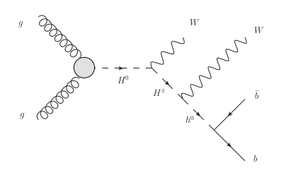
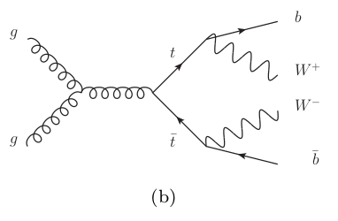
7. Decay of Higgs Boson Particles:
Fig. 1. (a) Diagram describing the signal process involving new exotic Higgs bosons H0 and H ± .
gg → H 0 → W ∓ H ± → W ∓ W ± h 0 → W ∓ W ± bb̄
Fig. 1. (b) Diagram describing the background process involving top-quarks (t).
gg → tt → W ∓ W ± bb̄

Slide 11
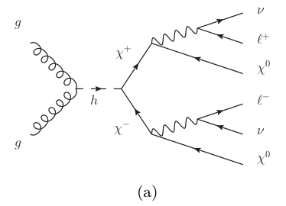
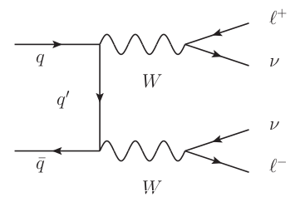
8. Decay of Supersymmetry Particles
Fig.2.(a) Describing the signal process involving hypothetical supersymmetric particles χ ± and χ 0 along with charged leptons ± and neutrinos ν.
gg → H 0 → W ∓ H ± → W ∓ W ± h 0 → W ∓ W ± bb̄
Fig. 2. (b) The background process involving W bosons
gg → tt → W ∓ W ± bb̄

Slide 12
9. Proposed methods:
Standard techniques include :
Feed-forward neural networks with a single hidden layer
Boosted - decision trees
TMVA package - standardized implementation of common multivariate learning techniques, excellent performance baseline

Slide 13
10. Main Challenge
To build an algorithm that quickly reconstructs particle tracks from 3D points left in the silicon detectors.

Slide 14
Work Done :
EDA (Exploratory Data Analysis)
WHY ??
a. To summarize the main characteristics of dataset by analysis
b. To validate assumptions and identify patterns
c. Good EDA can help increase the model accuracy
It constitutes 70% of your total project time!!
Notes:
EDA is crucial component of data science
https://www.kaggle.com/pavansanagapati/a-simple-tutorial-on-exploratory-data-analysis
https://www.analyticsvidhya.com/blog/2016/01/guide-data-exploration/
https://www.svds.com/value-exploratory-data-analysis/

Slide 15
Technical Details :
Handling data : Numpy, Pandas
Handling missing data : Missingno
Visualization : Matplotlib, Seaborn, Yellowbrick

Slide 16
HOW??
An EDA checklist
1. What question(s) are you trying to solve (or prove wrong)?
2. What kind of data do you have and how do you treat different types?
3. What’s missing from the data and how do you deal with it?
4. Where are the outliers and why should you care about them?
5. How can you add, change or remove features to get more out of your data?

Slide 17
Workflow of EDA
Remove unused columns
Remove duplicates
Handle missing data
Manipulating data types
Data Cleansing
Identifying relations between variables
Define Questions
Plot raw data
Plot statistics of the data
Visualization
Notes:
## To manipulate the columns easily, it is important that we make use of the python objects. Changing release date column into Date format and extracting the year from the date which will help us in analysing yearly data.
##MOVIE EXAMPLES
## Plotting the raw data (such as data traces, histograms, bihistograms, probability plots, lag plots, block plots, and Youden plots.
Plotting simple statistics such as mean plots, standard deviation plots, box plots, and main effects plots of the raw data.
Positioning such plots so as to maximize our natural pattern-recognition abilities, such as using multiple plots per page.

Slide 18
Prerequisites of project :
Statistics : Probability distributions (Bernoulli, Binomial, Uniform, Normal), P-value, PDF(Probability Density Function), CDF(Cumulative Distribution Function), Statistical Inference, CLT(Central Limit Theorem), Hypothesis
Bayesian Theory : Likelihood, Priors, Posteriors, MLE (Maximum Likelihood Estimation), MAP (Maximum A Posteriori ), Bayesian Regression, Naive bayes
Support Vector Machines : Support vectors, kernels - Radial basis function(RBF), Polynomial
Notes:
https://www.analyticsvidhya.com/blog/2017/09/6-probability-distributions-data-science/
https://www.youtube.com/watch?v=tFRXsngz4UQ&list=PLm9FYjKtq7PyxZOpQEd1duzQGQ-qi0cJU
,

Slide 19
Technical Details :
Bayesian : PyMC3
SVM : Sklearn

Slide 20
THANK YOU

